Slide 1
So, what is puberty?
4th Grade S.H.A.R.E.

Slide 2
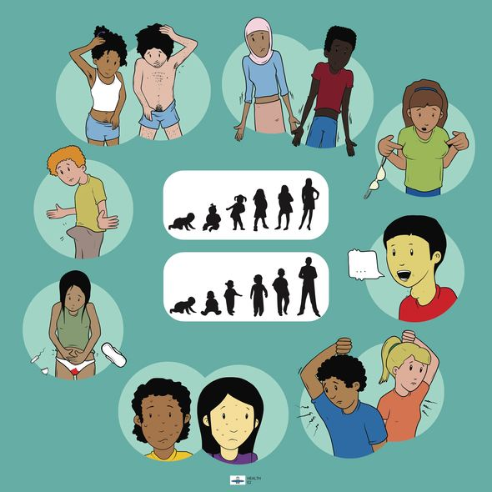
Puberty
T
It’s the time when your body begins to develop and change as you move from kid to adult.

Slide 3
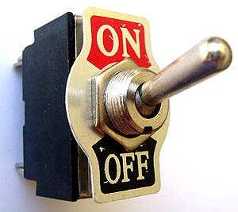
How Does puberty start?

Slide 4
What are some changes that occur during puberty?

Slide 5
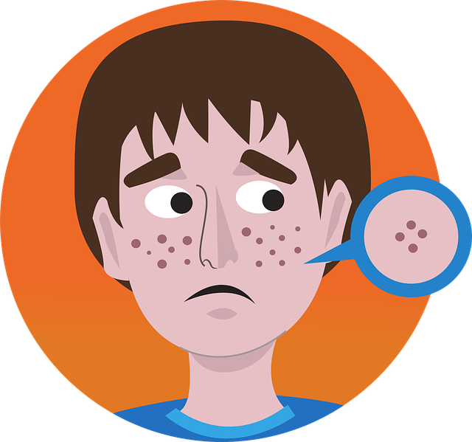
All bodies
Acne- aka zits
Sweat more- smells bad
Hair grows in new places
Under arms
Pubic area
May grow more hair on arms and legs
Hormones –cause extreme mood changes
Growing pains –pain in arms and legs
Muscle development
Body size changes
Grow taller
Gain weight

Slide 6
Boys and Bodies with a penis
Voice gets lower or deeper –may crack while it’s changing
Penis and testicles get bigger
Hair may grow on face, chest and back
Chest and shoulders get broader
Spontaneous erections
Wet dreams/nocturnal emissions
Some swelling around the nipples may occur and usually goes away.

Slide 7
Girls and Bodies with a Vulva
Breasts develop and get bigger
Hips get wider and body may become more curvy
Period begins (menstruation)

Slide 8
The Physical Changes That Happen to Everyone
The Physical Changes that Happen to Most Girls and Boys

Slide 9
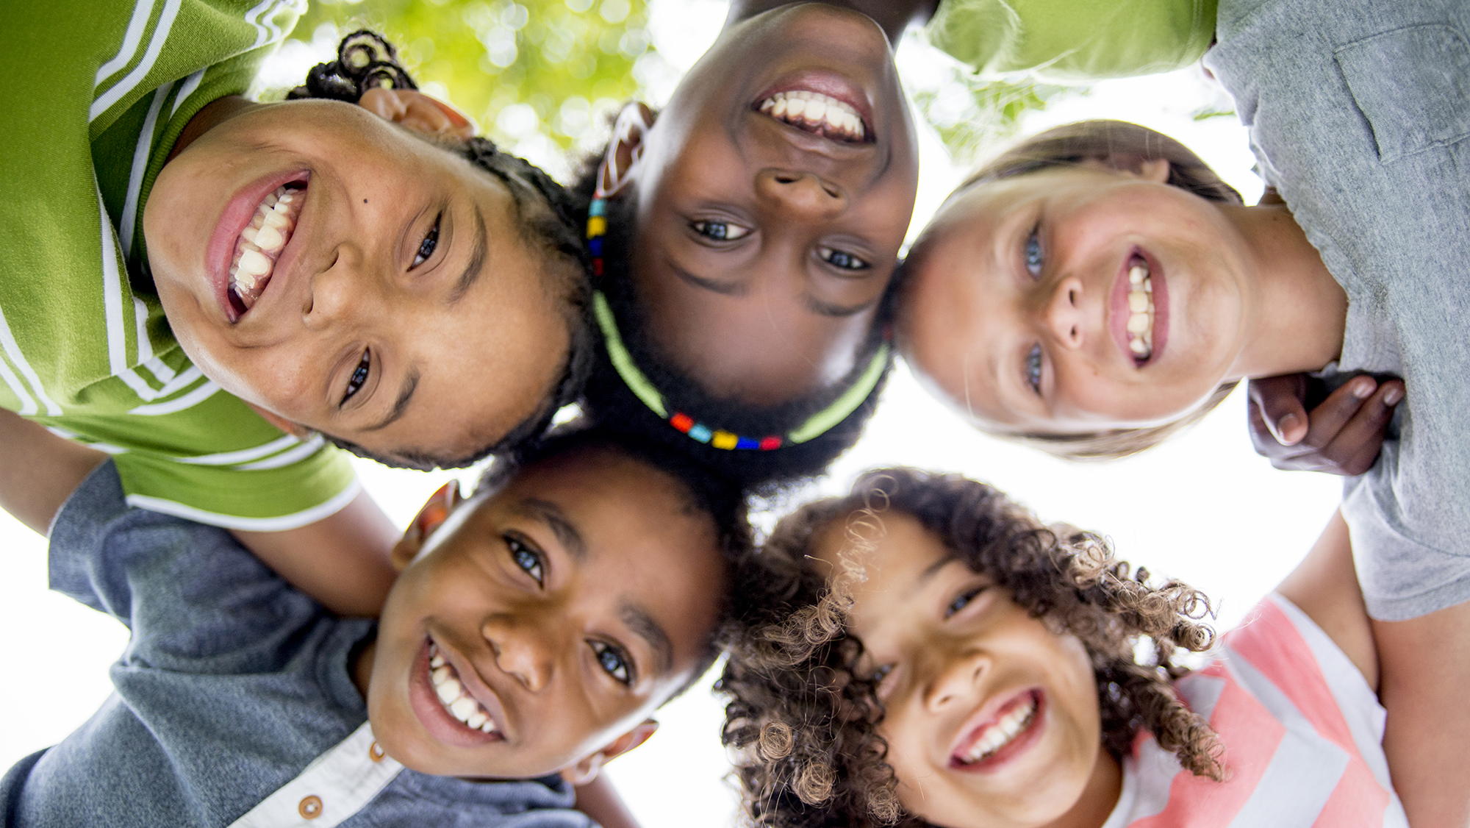
Social Changes
How you interact with others

Slide 10
Emotional changes
Your feelings and emotions begin to change

Slide 11
Physical changes

Slide 12
Can you identify the Change?
You will be given a sheet with either a physical, emotional or social change.
As a group, you will decide which heading your change falls under.
Once decided, one person will attach your change to the heading you feel it best fits under.

Slide 13
Puberty: Feeling depressed, happy and other emotions

Slide 14
Who can you talk to?
Parent or Guardian
Trusted adult
School Counselor
School Nurse
Teacher
Faith based leader
Health Clinic
Health care provider

